Slide 1












Dynamics 365 for Customer Service
Case Resolution Business Process
Identify
Research
Resolve
Case auto created
Gold customer
Available channels
Agent selects case from queue to work on
Knowledge article used to find resolution
Case routed to gold queue
Case resolved
Entitlement 15 cases
14
Gold SLA with 15 min response applied
14 Cases
remaining

Slide 2
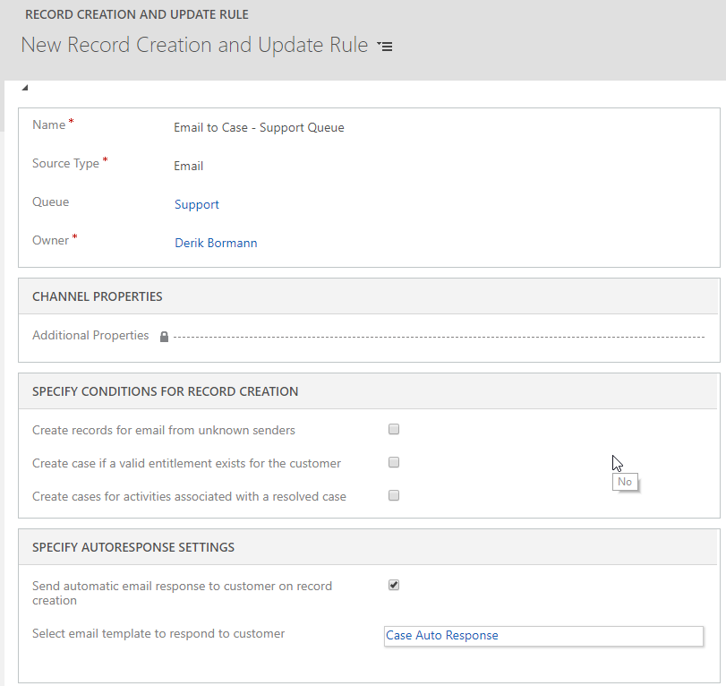
Defines the activity type to convert.
Specifies the queue the rule will be associated with.
Additional conditions can be supplied to provide greater flexibility.
Auto-responses may not fulfill SLA response requirements!

Slide 3
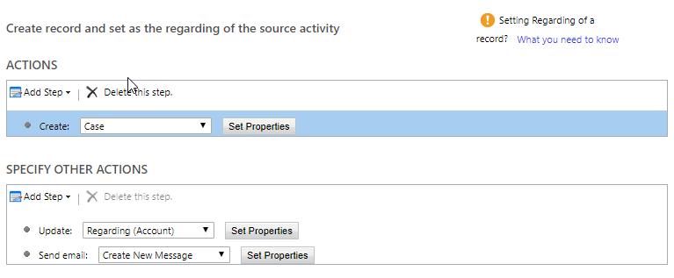
Only the ability to create a record is available.
Actions will affect the newly created record or related records.

Slide 4
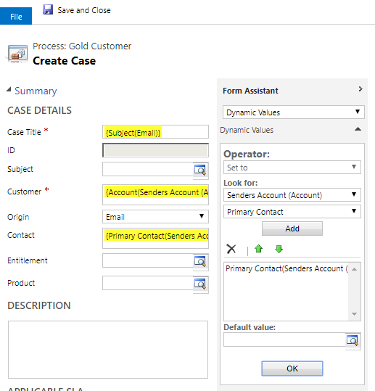
Use the Form Assistant to dynamically populate data from Dynamics 365 records
Dynamic Data will be noted with a yellow highlight.

Slide 5
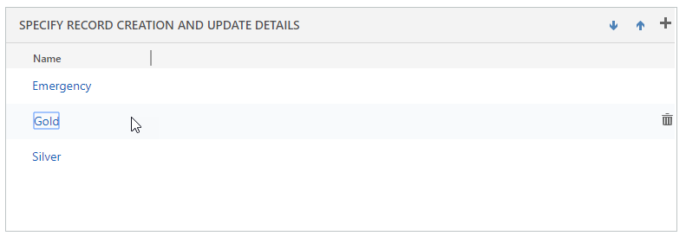
Use the arrows to change the order that rule items are evaluated.
Once the rule finds a match, it will stop checking additional rule items.

Slide 6
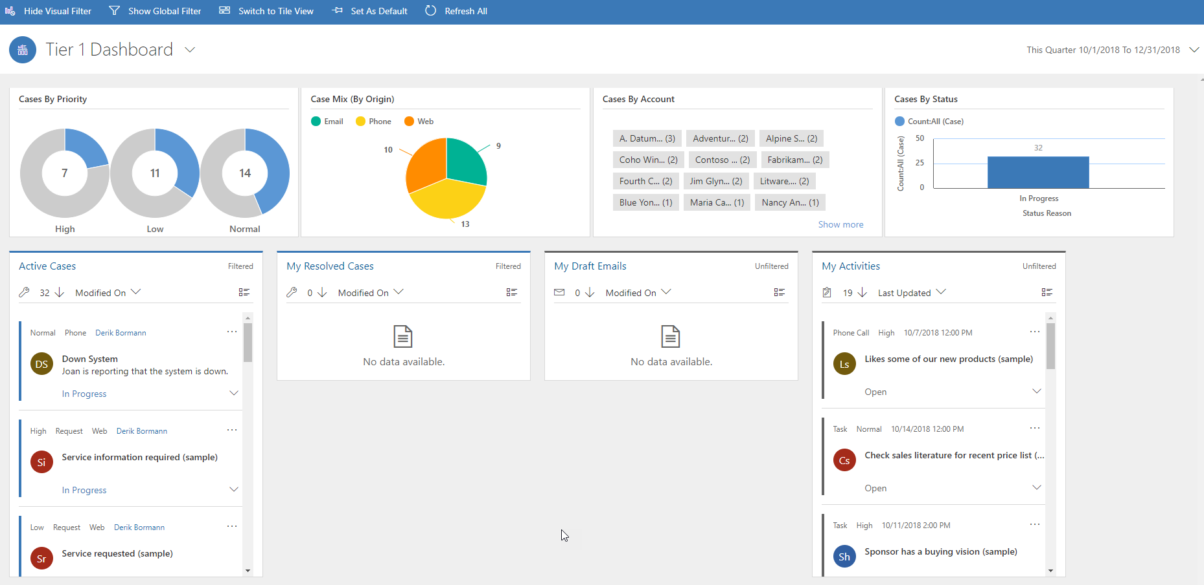
Toggle to show or hide visual filters that will further refine stream data.
Configurable filter that controls the date range of information.
Interactive filter.
Streams can be based on a Queue or Entity view.

Slide 7
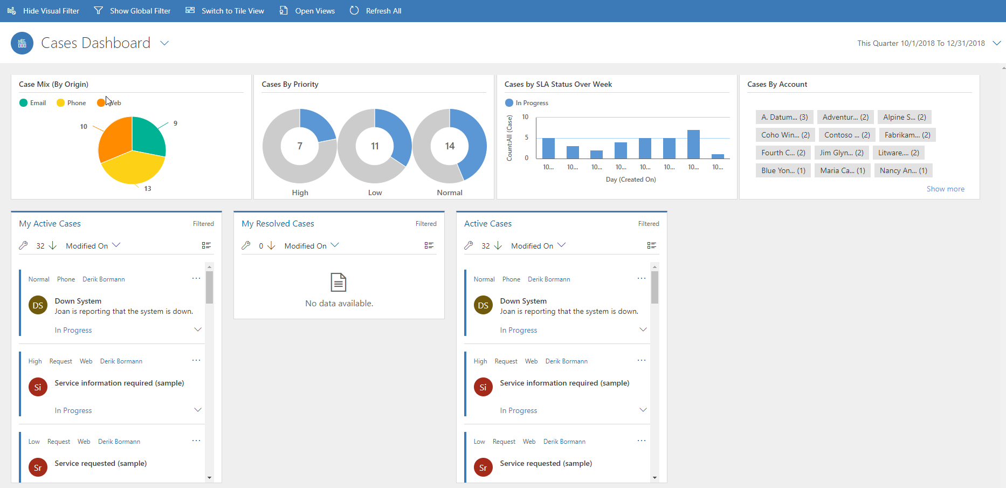
Switches back to Case related views.
Shows or Hides the Interactive filter.
Interactive Case filter.
Single streams that provides Case related data.

Slide 8
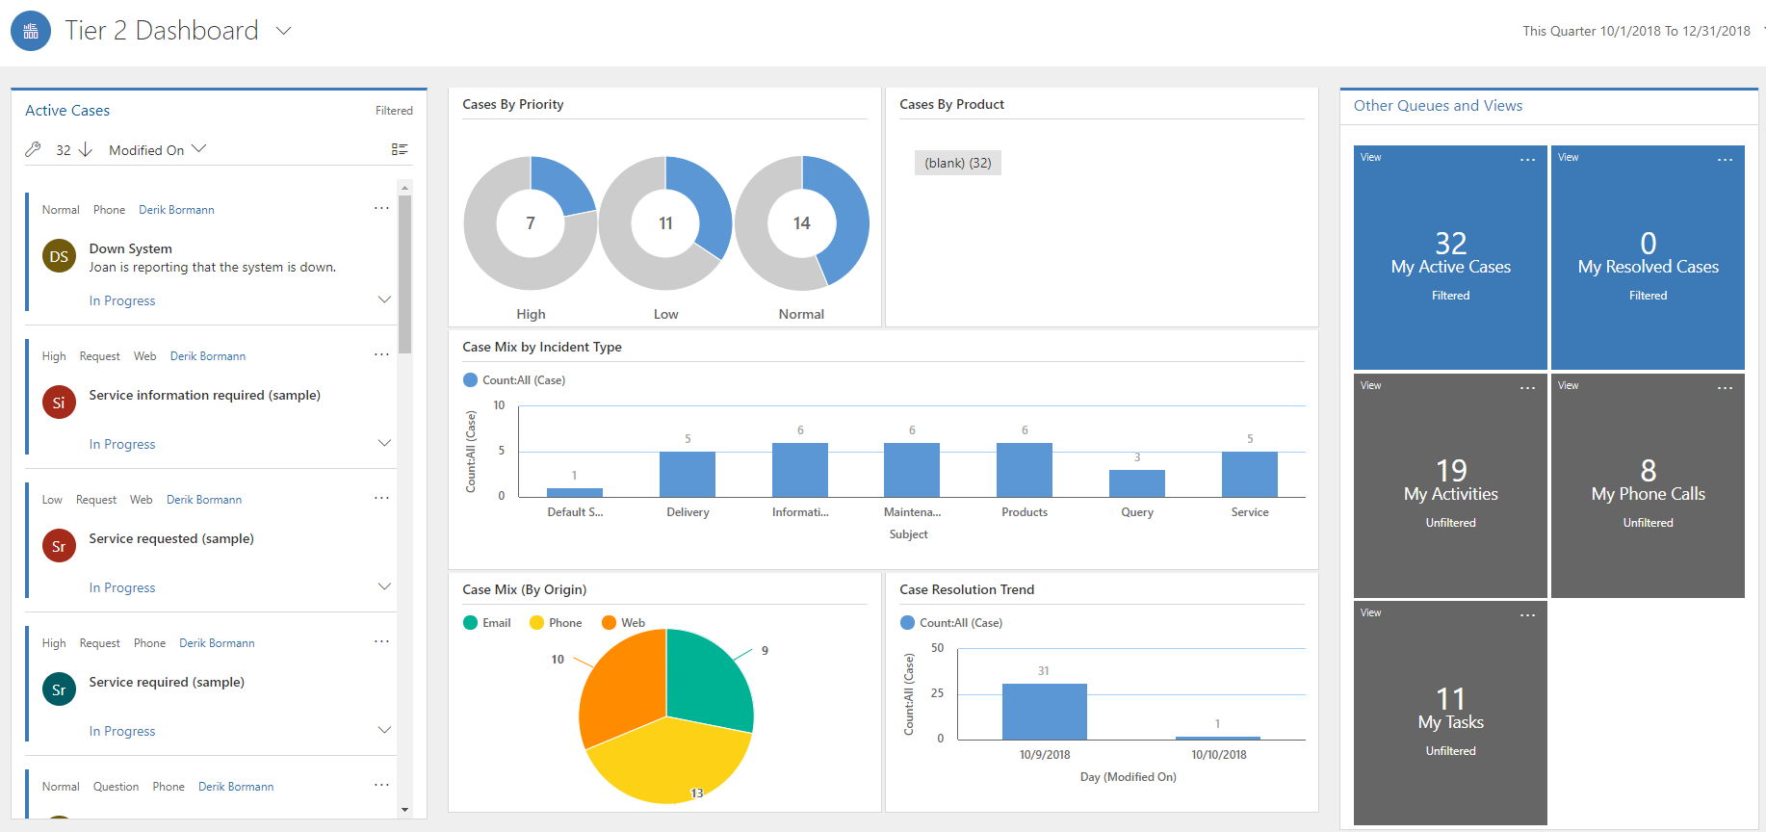
Interactive filter.
Interactive Tiles that displays data relevant and related to Cases.
Single stream that provides Active Case data.

Slide 9
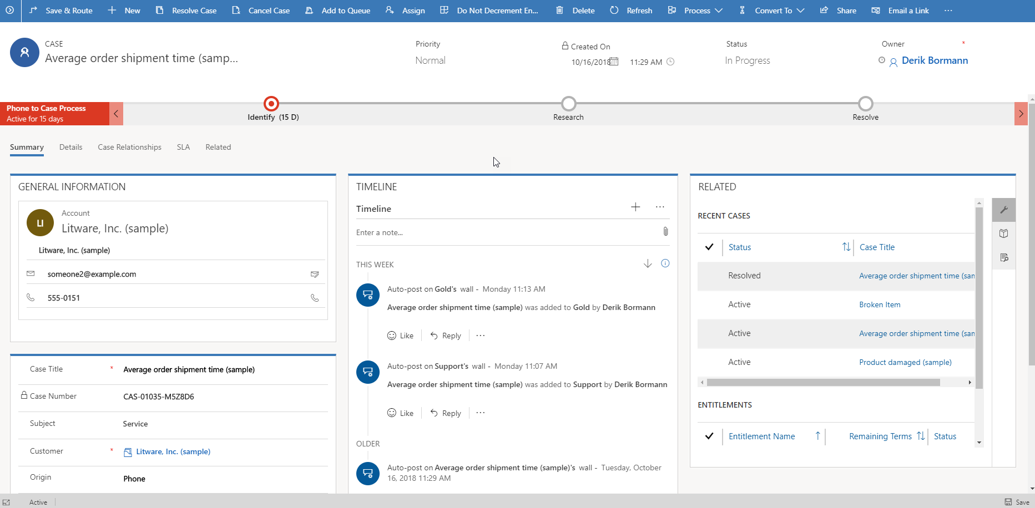
Allows switching to any BPF associated with the case entity
Displays the active process flow for the case
Icons represent related items available to view for the record.
New activities can be easily added.
Timeline displays related activities in chronological order.

Slide 10

Sample: Phone Call to Case lifecycle
Phone to Case: Business Process Flow
Identify
Research
Resolve
Customer: Adventure Works
Contact: Nancy Anderson
Related Case: Faulty Printer
Resolution Type: Problem Solved
Nancy Anderson places call for service
Dispatcher logs phone call activity
Agent converts phone call to case
30 min research task added to case
Knowledge Article used to find resolution
Nancy called about resolution 15 mins
Case resolved 1 hour billed to customer
15 min phone call added to case

Slide 11
Case Hierarchies (Parent / Child Cases)
Customer Issue (Parent)
HR Case
Child 1
Payroll
Child 2
Procurement
Child 3
One customer issue to track coordination across departments
Widely reported Issue (software bug)
Customer 1
Child 1
Customer 3
Child 3
Customer 2
Child 2
One root cause issue tied to several customers
Only ONE LEVEL of hierarchy supported
Notes:
Points of Note:
A parent case can have no more than 100 child cases attached to it.
Parent / Child is the only supported hierarchy (Grand Child Cases are supported).
Configuration
Same behavior as field mapping
Only available when creating a new child case from the parent case.
Child can inherit from all case fields including custom fields.
Does not keep records synced.
Can configure cascading preferences when parent is closed.

Slide 12
Dynamics 365: Case Merging Examples
Multiple Cases from same Customer
Cases from Multiple Contacts of same Account
Forgot Password
Please help me access online account
Channel: Web
Channel: Phone
Please help me access online account
Channel: Phone
Network Down
Sluggish Response
Sluggish Response

Slide 13
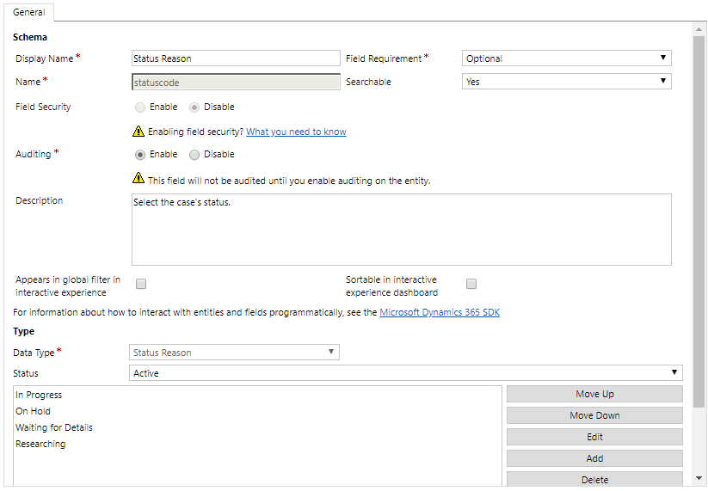
Drop-down box to select the status you want to work with
Available Status Reasons for the selected Status

Slide 14
Case Status Reason Transitions
Waiting for Details
Canceled
Service Escalated
Researching
In Progress
Canceled
In Progress
On Hold
Merged
On Hold
Solved
Solved
Merged
Canceled
Info Given
Canceled
Solved
Active Status
Escalate
Inactive Status
Resolved Status

Slide 15
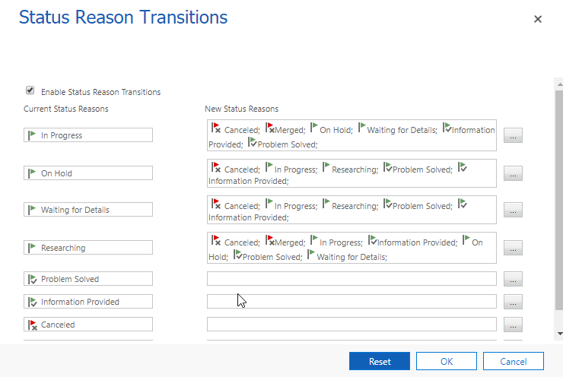
Active Status Reasons must provide at least one path to an inactive option

